Slide 1
Chapter 5: Large-scale
Dataflow engines
Group: InterDBE
Ismail, Vinu, Joshna, Jure

Slide 2




Content:
1- Introduction to dataflow engines
2- MapReduce and its evolution
3- Post MapReduce Technologies
4- Current trends and future directions

Slide 3
Introduction to
Dataflow engines

Slide 4




Limitations in Conventional Database Systems in the early 2000s
Scalability: designed for a single server environment
Fixed Schema Constraints: RDBMS requires pre-defined schema
Cost and Complexity of scaling: Scaling out (horizontally) a conventional database system involves significant complexity and cost.
Fault Tolerance: A single point of failure could jeopardize the entire system’s availability and reliability.
Limited Support for Big Data and Analytics: The Three V’s (volume, velocity, variety)
Where increasing exponentially that a DBMS cannot handle

Slide 5
What also was going on in the early 2000s

Slide 6


Motivation
INCREASING DATA VOLUMES
CHEAP COMMODITY STORAGE

Slide 7
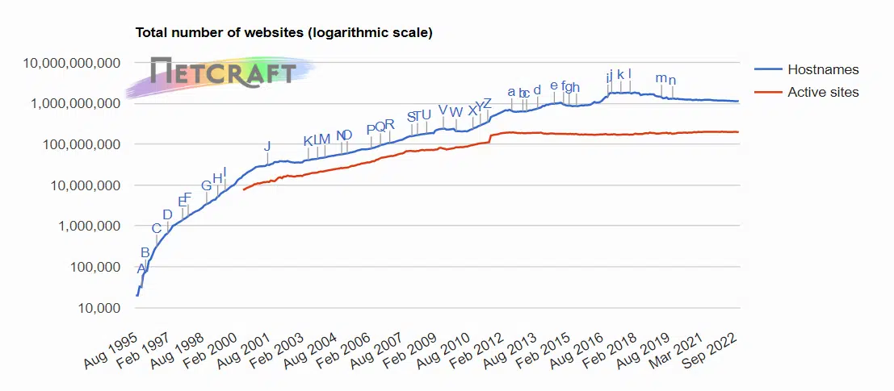
INCREASING DATA VOLUMES
•The number of websites is increasing on a logarithmic scale
•Google Web Crawler was collecting a significant amount of website pages.
•Google needed a way to have better search indexing

Slide 8
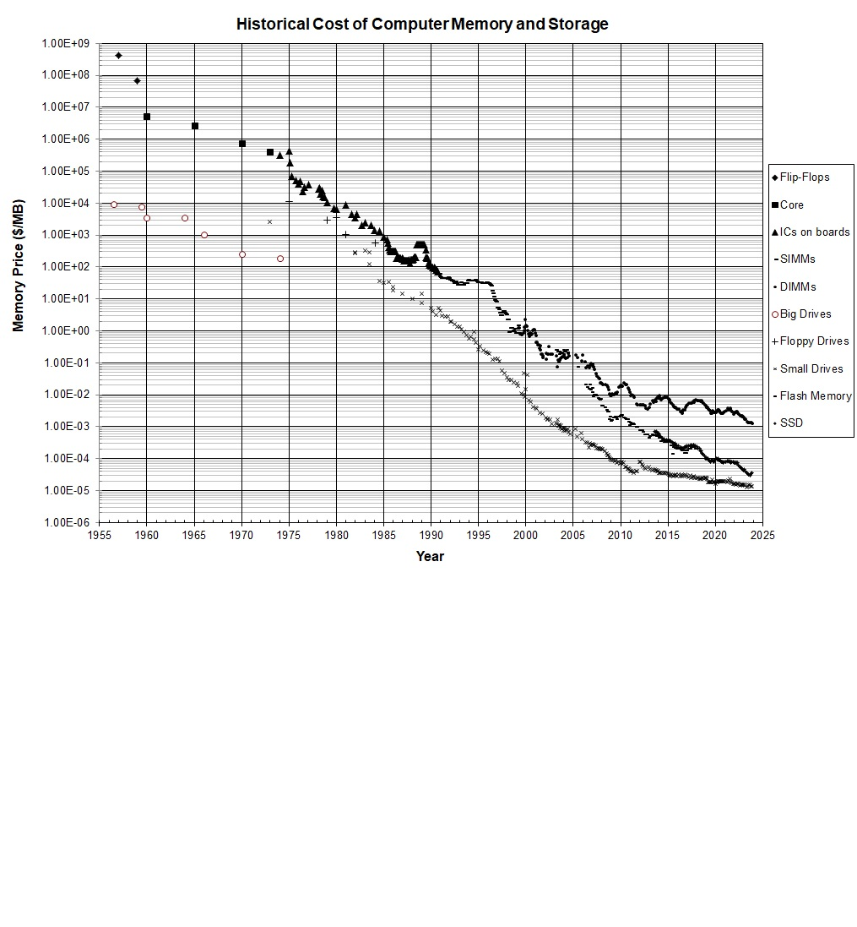
CHEAP COMMODITY STORAGE
Observation: exponential decrease in memory prices over time.
Source: https://jcmit.net/memoryprice.htm

Slide 9
Given the limitations of traditional databases and the Increasing availability of commodity storage and the exponential increase of data, How did the tech industry respond to handle that data in a more advanced way ?
The tech industry started building new systems called dataflow engines. But what are they?

Slide 10


Dataflow Engines
Dataflow engines are advance computational framework that orchestrate distributed and parallel processing tasks across a network of nodes (interconnected computers).
In general, Dataflow engines employ a master node and a worker nodes.
Responsibilities for each type of node
Master Node | Worker Node
1- manage the distribution of the tasks and partition the data to the worker nodes 2- Monitor process of the worker nodes 3- handle failures during execution by detecting the failures from the worker nodes. | 1- Perform the actual data processing 2- Local Data Management 3- contribute to fault tolerance

Slide 11
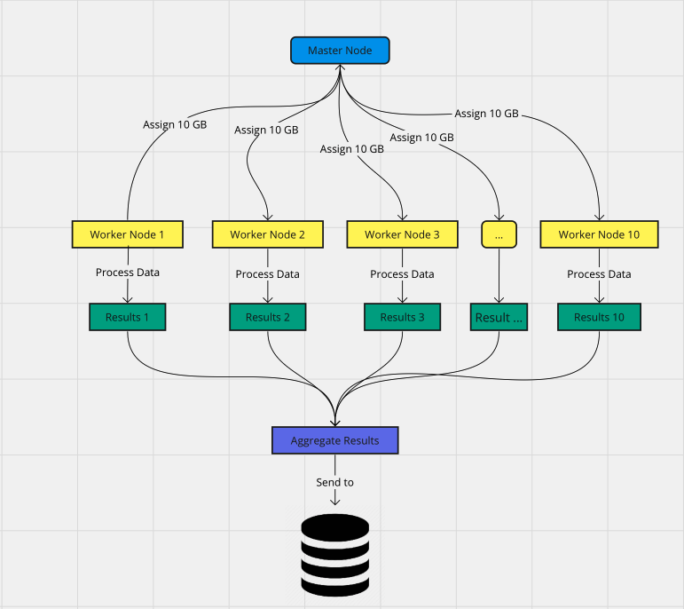
Basic idea of how dataflow engines work
For example, 100 GB of data needs to be processed with 10 Worker nodes
Master Node: organize and manage the data across the cluster
Worker nodes: perform operations on each chunk of data
Process data edge: some operation like counting words
Aggregated Result: The result aggregation depends on the system, and then the result is sent to a storage, database, application dashboard, etc.

Slide 12
MapReduce and its evolution

Slide 13
Introduction of MapReduce
Notes:
MapReduce was introduced by Google in 2004 to address the challenges of processing large-scale data sets efficiently on distributed clusters.

Slide 14
Growing demand for processing large-scale datasets generated by web services and other applications.
Traditional parallel processing approaches are insufficient for handling massive datasets effectively.
Motivation
Notes:
Motivation: As mentioned before there was an increasing need for processing large-scale datasets generated by web services and other applications during this time. Traditional approaches to parallel processing were found to be insufficient for handling these massive datasets effectively.

Slide 15
Scalability, fault tolerance, and ease of programming are major challenges in processing large-scale data.
Existing parallel programming models are complex and lack efficient fault tolerance and scalability mechanisms.
Challenges
Notes:
Challenges: There were several challenges in processing large-scale data. Like fault tolerance and ease of programming. Existing parallel programming models and systems were very complex and lacked efficient mechanisms for fault tolerance and scalability.

Slide 16
MapReduce aims to provide a simple and scalable programming model for processing large-scale datasets on distributed clusters.
It enables developers to write parallelizable computations easily while handling distributed system complexities transparently.
Objective
Notes:
Objective: The primary objective of MapReduce, was to provide a simple and scalable programming model for processing large-scale data sets on distributed clusters.

Slide 17
MapReduce
MapReduce is a programming model and processing framework designed for handling large-scale data processing tasks in a distributed manner.
It is widely used for processing and generating insights from massive datasets, leveraging the power of parallelism and fault tolerance.
MapReduce breaks down a large task into smaller, manageable tasks, processes them in parallel across multiple nodes, and then combines the results to obtain the final output.
Popularized by Google and later implemented in open-source frameworks like Apache Hadoop.
Notes:
MapReduce has the ability to process large scale data in a distributed manner. It is used for processing and generating insights from massive datasets by using the power of parallelism and fault tolerance. MapReduce breaks down a large task into smaller, manageable tasks, processes them in parallel across multiple nodes, and then combines the results to obtain the final output.
Popularized by Google and later implemented in open-source frameworks like Apache Hadoop

Slide 18
Components of MapReduce
Mapper Function: Transforms input data into intermediate key-value pairs.
Reducer Function: Aggregates and processes intermediate key-value pairs to produce the final output.
Partitioner: Determines which reducer should receive each intermediate key-value pair based on a partitioning function.
Notes:
There are 3 main components;
Mapper Function
Reducer Function
Partitioner
Mapper Function: It transforms the input data into intermediate key-value pairs.
Reducer Function: The reducer function then processes these pairs, aggregates the values associated with each key, and produces the final output.
Partitioner: Determines which reducer should receive each intermediate key-value pair based on a partitioning function. This ensures that all key-value pairs with the same key are sent to the same reducer.

Slide 19
Execution Flow of MapReduce
Shuffling & sorting
Mapper
Reducer
Mapper
Reducer
Mapper
Reducer
Input: Big data
Output
Notes:
Execution flow of MapReduce
Input Splitting: The input data is divided into fixed-size splits, (typically 64MB to 128MB each). These splits are then assigned to individual mapper tasks.
Mapping: Each mapper task processes its input split independently and generates intermediate key-value pairs.
Shuffling and Sorting: The intermediate key-value pairs are shuffled across the network and sorted based on keys. This ensures that all values associated with the same key are grouped together.
Reducing: Reducer tasks receive the sorted intermediate key-value pairs and process them to produce the final output.

Slide 20
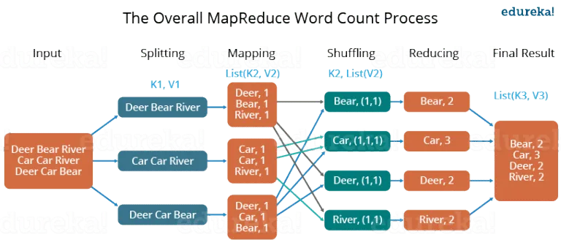
Example
Notes:
Now, suppose, we have to perform a word count on some document using MapReduce. So, we will be finding unique words and the number of occurrences of those unique words.
First, we divide the input into three splits as shown in the figure. This will distribute the work among all the map nodes.
Then, we tokenize the words in each of the mappers and give a hardcoded value (1) to each of the tokens or words.
Now, a list of key-value pairs will be created where the key is nothing but the individual words and the value is one.
The mapping process remains the same on all the nodes.
After the mapper phase, a partition process takes place where sorting and shuffling happen so that all the tuples with the same key are sent to the corresponding reducer.
So, after the sorting and shuffling phase, each reducer will have a unique key and a list of values corresponding to that very key.
Now, each Reducer counts the values which are present in that list of values and gives the final output
Finally, all the output key/value pairs are then collected and written in the output file.

Slide 21
Advantages of MapReduce Implementation
Scalability: Enables processing of large datasets by distributing the workload across multiple nodes.
Fault Tolerance: Provides fault tolerance by replicating data and re-executing failed tasks.
Parallelism: Processes data in parallel, leading to high throughput and reduced processing time.
Ecosystem Support: Rich ecosystem of tools and libraries extends functionality.
Parallelism: Processes data in parallel, leading to high throughput and reduced processing time.
Notes:
Advantages of MapReduce Implementation
Scalability:
MapReduce enables the processing of massive datasets by distributing the workload across multiple nodes in a cluster. It can scale horizontally by adding more nodes to the cluster, allowing organizations to handle ever-growing volumes of data without significant performance degradation.
Fault Tolerance:
MapReduce frameworks, such as Apache Hadoop, provide built-in fault tolerance mechanisms to handle node failures gracefully. Tasks are automatically re-executed on other nodes if a failure occurs, and data replication ensures that data loss is minimized. This ensures the reliability of data processing tasks, even in the presence of hardware failures or network issues.
Parallelism:
By dividing the input data into smaller chunks and processing them in parallel, leads to improved performance and reduced processing times, as multiple nodes can work on different parts of the dataset simultaneously.
Ecosystem Support:
MapReduce frameworks, such as Apache Hadoop, have a rich ecosystem of tools and libraries that extend its functionality. These include components for data storage (HDFS), resource management (YARN), SQL querying (Apache Hive), machine learning (Apache Mahout), and real-time processing (Apache Spark Streaming). This ecosystem support enhances the capabilities of MapReduce and enables organizations to build end-to-end data processing pipelines.
….
Data Locality: MapReduce frameworks optimize data locality by scheduling tasks closer to the data they need to process. This reduces network traffic and improves performance by minimizing data transfer across the network. It leverages the principle of moving computation to the data instead of moving data to the computation.
Flexibility: MapReduce provides a flexible programming model that can be applied to a wide range of data processing tasks. It supports various data formats and allows developers to write custom map and reduce functions tailored to specific use cases. This flexibility makes MapReduce suitable for a diverse set of applications, including batch processing, ETL (Extract, Transform, Load) operations, and data analytics.

Slide 22
Shortcomings of MapReduce Implementation
High Latency: Multiple disk I/O and network shuffling stages lead to high latency.
Limited Optimization: Lack of advanced optimization techniques affects performance.
Programming Complexity: Handling low-level details makes development complex.
Batch Processing: Designed primarily for batch processing, not real-time or low-latency tasks.
Notes:
Shortcomings of MapReduce
High Latency:
MapReduce involves multiple stages of disk I/O and network shuffling, resulting in high latency for processing jobs, especially for iterative algorithms and interactive queries.
Limited Optimization:
MapReduce frameworks, such as Apache Hadoop, may lack advanced optimization techniques available in newer processing frameworks. For example, MapReduce does not leverage in-memory computing extensively, which can lead to suboptimal performance for certain types of workloads compared to frameworks like Apache Spark.
Programming Complexity:
Writing MapReduce programs can be complex, as developers need to handle low-level details such as data serialization, partitioning, and fault tolerance, which can be challenging and time-consuming.
Batch Processing Focus:
MapReduce is primarily designed for batch processing of data, where data is processed in discrete batches or jobs. While this is suitable for many use cases, it may not be ideal for applications requiring real-time or interactive processing of data streams.
Conclusion
Overall, MapReduce played an important role in addressing the shortcomings of early dataflow engines by introducing innovations in programming models, fault tolerance, resource management, and support for diverse data processing workloads. Its contributions have influenced the design and evolution of modern dataflow engines, leading to more scalable, efficient, and versatile distributed computing frameworks.
……
Resource Overhead: MapReduce jobs often involve a significant amount of overhead, including job setup, task scheduling, and data shuffling. This overhead can reduce overall cluster efficiency, especially for short-lived or small-scale jobs that do not fully utilize cluster resources.
Data Skew: In some cases, the distribution of data across partitions may be uneven, leading to data skew. This can result in certain reducers being overloaded with data, while others remain underutilized, impacting overall performance.

Slide 23
Post MapReduce Technologies
Notes:
Next, we are going to talk about kind of the aftermath of MapReduce. MapReduce in itself isn’t as relevant anymore compared to the other technologies it paved the way for.

Slide 24
The Hadoop MapReduce Implementation
There wasn’t much traction until Yahoo open-sourced the Hadoop implementation
Stimulated a range of projects: Dryad, Hive and Pig
Attracted developers and VC investment
Research started investigating solutions for straggler mitigation, fault tolerance, and alternative programming models
Notes:
MapReduce really didn’t attract much attention from the database when the paper was first published in 2003. It was very specific to google. But when Yahoo open-sourced the Hadoop MapReduce implementation, all eyes were on it. {For anyone who doesn’t know what Hadoop is, because I didn’t, it’s an open-source framework for distributed storage. It can process large datasets across clusters of computers using simple programming models} This is really when MapReduce started becoming more popular. Within a year, all the big names started developing their own versions of it: Microsoft started of Dyrad, Facebook worked on Hive and Pig was Yahoo’s project. So, starting 2006, post-MapReduce systems, which is how the text refers to these systems, gained a lot of attention from developers and Venture capitalists. These systems focused on different aspects of the original MapReduce system that could be improved. So a lot of research effort was put into issues like scheduling{which refers to managing the execution of MapReduce jobs across a cluster of machines efficiently}, straggler mitigation{which tries to make it so that there are fewer stragglers which slow down the overall execution time of a MapReduce job}, fault tolerance{which is just being able to handle failures in DataNodes}, UDF query optimization{UDF=user-defined functions. They were trying optimize these to improve the performance and efficiency of the overall job} and alternative programming models.

Slide 25
Post-MapReduce Systems
Expanded interface and functionality to include more sophisticated declarative interfaces, query optimization strategies, and efficient runtimes.
Today’s technologies implement features from RDBMs.
In the Hadoop ecosystem, data flow engines became the substrate for higher level functionality.
DryadLINQ: most interesting for its interface
Notes:
Soon, all the improvements that I mentioned were being researched earlier were included in the post-MapReduce systems. Today’s MapReduce systems that stemmed out during this time implement a lot of the features of traditional relational database management systems. The latest generation of these systems expose higher-level query languages such as SQL and use advanced execution strategies. In the Hadoop ecosystem specifically, data flow engines became the foundation for other higher level functionality, including declarative interfaces, graph processing and machine learning. The authors make a special mention about DryadLINQ{it is a programming framework that combines two important concepts: Dryad, a distributed execution engine for large-scale data processing, and LINQ (Language Integrated Query), a component of the .NET Framework for querying data from various sources using a unified syntax.}, which they say is most interesting for its interfaces. It integrates very well with Microsoft’s .NET LINQ to provide a parallelized collections library{this is a software component that allows for parallel processing of data stored in collections. These libraries are designed to simplify parallel algorithms by providing high-level abstractions and APIs for working with collections of data in a concurrent manner.}. DyradLINQ’s interface is considered to be of a higher-level than MapReduce. It’s basic query optimization and lightweight fault tolerance proved influential in later dataflow engines. Apache spark would also be a good example of post MapReduce technologies. Spark allows for in-memory processing, which can speed up iterative algorithms and interactive data analysis compared to MapReduce. Spark's approach to fault tolerance through RDDs can be more efficient for certain types of workloads.

Slide 26
Impact and Legacy
Schema Flexibility
Interface Flexibility
Architectural Flexibility
Notes:
Moving on, we are going to talk about what the authors say are the three most important things that MapReduce has contributed to. These three ideas, schema flexibility, interface flexibility, architectural flexibility, weren’t necessarily novel but the authors believe that they wouldn’t have become so relevant and broadly used if it weren’t for MapReduce.

Slide 27
Schema Flexibility
MapReduce systems can process arbitrarily structured data.
Major shift from traditional data warehouses: key factor behind the rise of “Big Data”
ETL tasks for major workload for post-MapReduce engines
Impacts novices, experts and architects.
Notes:
The first, Schema flexibility, simply refers to the fact that MapReduce systems can process arbitrarily structured data. This makes it so that there is no loading step. The data doesn’t have to clean or curated. The authors say that this is a huge contrast to the “walled garden” way that traditional data warehouse systems work. Along with this, it’s also important to note that storage is cheaper than traditional warehouse systems. Both of these things coupled together allow users to store the data for longer and longer. This is the reason why the authors say that this schema flexibility is a key factor behind the rise of “Big Data.” This phenomenon also resulted in the growth of semi-structured storage formats. But because of this, these systems do take much longer for Extract, transform, load tasks. Overall, the authors believe that this phenomenon impacts data management at all levels, analyst to programmer to analytics vendor, and is quite influential and will become even more so in the future.

Slide 28
Interface Flexibility
Interfaces that allow users to program using a combination of paradigms.
Make user-defined computations easier to express
Strong selling point for data selling officers
Impacts experts and architects
Notes:
Coming to interface flexibility, the authors believe that this impacts experts and architects the most. When they say interface flexibility, they are referring to interfaces being able to support a number of different interacting options for users: an organization might want to use imperative code to parse a file, use SQL to create columns, and machine learning to cluster the results. And they want to do all this on one interface. The flexibility of today’s engines allows them to this whereas traditional database engines don’t. While traditional database engines do support user-defined computations, today’s engines make it easier to express user-defined computation and to integrate the results from user-defined function with the results of queries constructed in SQL. As I already mentioned, this is particularly attractive to programmers: the combining of ETL, analytics, and post-processing in a single interface.

Slide 29
Architectural Flexibility
Hadoop ecosystems builds data warehouses as a series of modules
Write and run programs against the raw file system or any number of dataflow engines.
Adds flexibility overhead
Impacts architects, system builders and vendors
Notes:
The last phenomenon that the authors talked about is architectural flexibility. One thing that's not desirable in traditional databases is how strongly coupled the storage, query processing, and memory management are. This is not a problem in the post MapReduce systems because they are built bottom up with the Hadoop ecosystem. Organizations can write queries against the raw filesystems, or use dataflow engines such as Spark or use analytics packages such as Graphlab etc. Yes, this flexibility comes with performance overhead. But it is of particular interest to system builders because it provides them with additional freedom in building their infrastructure.

Slide 30
Today's distributed data management infrastructures excel in flexibility and heterogeneity: of storage formats, of computation paradigms, and system implementations
Notes:
To conclude this section, today's distributed data management infrastructures excel in flexibility and heterogeneity: of storage formats, of computation paradigms, and system implementations.The most important of these is the heterogeneity of storage formats because it impacts everybody in the field: novices, experts and architects. However, all three are relevant, and there is still scope for improvements and research in all the areas.

Slide 31
Current Trends & Future Directions

Slide 32

Dataflow Engines
Data engines are a critical tool for processing large number of data.
Data Engines
evolved from
MapReduce
To systems such as
Apache Spark

Slide 33





The Current Trends in Dataflow Engines
Consolidationx
Consolidation
Increased Flexibility and Heterogeneity
Schema Flexibility
Interface Flexibility
Architectural Flexibility
Integration with Specialized Systems
Consolidation and Maturity

Slide 34

The Rise and Fall of MapReduce
Intro & Disruption
The Rise
Popularity
Open Source
MapReduce
Critiques & Limitations
The SQL Shift
The Fall
Evolution
Stonebraker’s Critique

Slide 35


Spark’s Problem
The Problem:
The Challenges:
A high percentage of the Spark accesses are through SparkSQL. This is an issue because its primary identity shifts towards an SQL platform and overshadows it as a distributed applications platform.
Need for mechanisms for persistence, indexing, and metadata.
The main memory limitation and integration.

Slide 36
The Future Directions in Data Engines
Specialized Systems for the Performance
Integration and Evolution Towards Versatility
Improvement of the SQL Capabilities
Adoption of New Interfaces and Systems
Growth in Commercial & Open Source
Closing of the Gap with Traditional Warehouses & Post-MapReduce Systems

Slide 37





Key Takeaways
Diverse Outlook
Versatility & Flexibility
Ecosystem Growth
Closing the Gaps
Looking Ahead

Slide 38
Questions?

